Slide 1
Relationship Types, Relationship Sets, Roles, and Structural Constraints
Binary Relationship constraints
Attributes of Relationship Types
Relationship types can also have attributes, similar to those of entity types.
For example,
record the number of hours per week that a particular employee works on a particular project, in WORKS_ON relationship type
Another example
Record the Start_date on which a manager started managing a department for the MANAGES relationship type

Slide 2
Relationship Types, Relationship Sets, Roles, and Structural Constraints
Binary Relationship constraints
Attributes of Relationship Types
Notice that attributes of 1:1 or 1:N relationship types can be migrated to one of the participating entity types.
For example, the Start_date attribute for the MANAGES relationship can be an attribute of either EMPLOYEE (manager) or DEPARTMENT, although conceptually it belongs to MANAGES. This is because MANAGES is a 1:1 relationship, so every department or employee entity participates in at most one relationship instance.
Hence, the value of the Start_date attribute can be determined separately, either by the participating department entity or by the participating employee (manager) entity.

Slide 3
Relationship Types, Relationship Sets, Roles, and Structural Constraints
Binary Relationship constraints
Attributes of Relationship Types
For a 1:N relationship type, a relationship attribute can be migrated only to the entity type on the N-side of the relationship.
For example, in Figure 3.9, if the WORKS_FOR relationship also has an attribute Start_date that indicates when an employee started working for a department, this attribute can be included as an attribute of EMPLOYEE.
This is because each employee works for at most one department, and hence participates in at most one relationship instance in WORKS_FOR, but a department can have many employees, each with a different start date.

Slide 4
Relationship Types, Relationship Sets, Roles, and Structural Constraints
Constraints on Binary Relationship Types
Attributes of Relationship Types
For M:N (many-to-many) relationship types, some attributes may be determined by the combination of participating entities in a relationship instance, not by any single entity.
Such attributes must be specified as relationship attributes.
An example is the Hours attribute of the M:N relationship WORKS_ON (Figure 3.13); the number of hours per week an employee currently works on a project is determined by an employee-project combination and not separately by either entity.

Slide 5
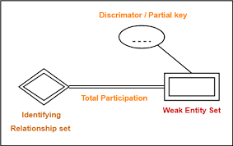
Weak Entity Types
Entity types that do not have key attributes of their own are called weak entity types.
Entities belonging to a weak entity type are identified by being related to specific entities from another entity type in combination with one of their attribute values.
We call this other entity type the identifying or owner entity type, and we call the relationship type that relates a weak entity type to its owner the identifying relationship of the weak entity type.
Employee
Dependent
has
Owner entity type
Identifying relationship

Slide 6
Weak Entity Types
A weak entity type always has a total participation constraint (existence dependency) w.r.t its identifying relationship because a weak entity cannot be identified without an owner entity.
However, not every total participation results in a weak entity type.
For example,
a DRIVER_LICENSE entity cannot exist unless it is related to a PERSON entity, even though it has its own key (License_number) and hence is not a weak entity.

Slide 7
Weak Entity Types
Consider the entity type DEPENDENT, related to EMPLOYEE, which is used to keep track of the dependents of each employee via a 1:N relationship.
In our example, the attributes of DEPENDENT are Name (the first name of the dependent), Birth_date, gender and Relationship (to the employee).
Two dependents of two distinct employees may, by chance, have the same values for Name, Birth_date, gender, and Relationship, but they are still distinct entities.
They are identified as distinct entities only after determining the particular employee entity to which each dependent is related.
Each employee entity is said to own the dependent entities that are related to it.

Slide 8
Weak Entity Types
A weak entity type normally has a partial key, which is the attribute that can uniquely identify weak entities that are related to the same owner entity.
In our example,
if we assume that no two dependents of the same employee ever have the same first name, the attribute Name of DEPENDENT is the partial key.
In ER diagrams representation, weak entity type and its identifying relationship are distinguished by surrounding their boxes and diamonds with double lines respectively.
The partial key attribute is underlined with a dashed or dotted line.

Slide 9
Weak Entity Types
Weak entity types can sometimes be represented as complex (composite, multivalued) attributes.
In the preceding example, we could specify a multivalued attribute Dependents for EMPLOYEE, which is a multivalued composite attribute with the component attributes Name, Birth_date, gender, and Relationship.

Slide 10
Refining the ER Design for the COMPANY Database
In our example, we specify the following relationship types:
■ MANAGES,
which is a 1:1(one-to-one) relationship type between EMPLOYEE and DEPARTMENT.
EMPLOYEE participation is partial.
The attribute Start_date is assigned to this relationship type.
■ WORKS_FOR,
a 1:N (one-to-many) relationship type between DEPARTMENT and EMPLOYEE.
Both participations are total.
■ CONTROLS,
a 1:N relationship type between DEPARTMENT and PROJECT.
The participation of PROJECT is total,
whereas that of DEPARTMENT is determined to be partial, after consultation with the users indicates that some departments may control no projects.

Slide 11
Refining the ER Design for the COMPANY Database
In our example, we specify the following relationship types:
■ SUPERVISION,
a 1:N relationship type between EMPLOYEE (in the supervisor role) and EMPLOYEE (in the supervisee role).
Both participations are determined to be partial, after the users indicate that not every employee is a supervisor and not every employee has a supervisor.
■ WORKS_ON,
an M:N (many-to-many) relationship type with attribute Hours, after the users indicate that a project can have several employees working on it.
Both participations are determined to be total.
■ DEPENDENTS_OF,
a 1:N relationship type between EMPLOYEE and DEPENDENT, which is also the identifying relationship for the weak entity type DEPENDENT.
The participation of EMPLOYEE is partial, whereas that of DEPENDENT is total.

Slide 12
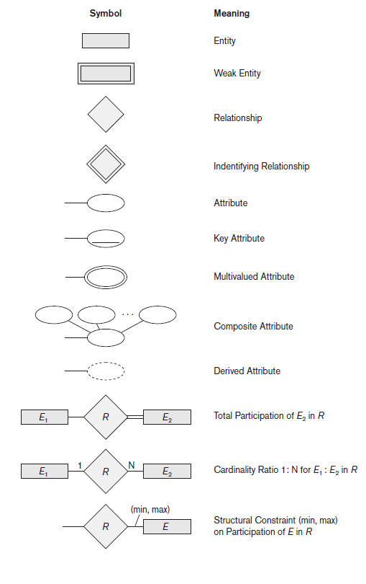
ER Diagrams, Naming Conventions, and Design Issues
Summary of Notation for ER Diagrams

Slide 13
ER Diagrams, Naming Conventions, and Design Issues
Proper Naming of Schema Constructs
Choose names that convey, as much as possible. (meaningful names)
Use singular names for entity types, rather than plural ones, because the entity type name applies to each individual entity belonging to that entity type.
Entity type and relationship type names are in uppercase letters,
Attribute names have their initial letter capitalized,
and role names are in lowercase letters.

Slide 14
A Sample Database Application
The company is organized into departments. Each department has a unique name, a unique number, and a particular employee who manages the department. We keep track of the start date when that employee began managing the department. A department may have several locations.
A department controls a number of projects, each of which has a unique name, a unique number, and a single location.
The database will store each employee’s name, Social Security number, address, salary, sex (gender), and birth date. An employee is assigned to one department, but may work on several projects, which are not necessarily controlled by the same department. It is required to keep track of the current number of hours per week that an employee works on each project, as well as the direct supervisor of each employee (who is another employee).
The database will keep track of the dependents of each employee for insurance purposes, including each dependent’s first name, sex, birth date, and relationship to the employee.

Slide 15
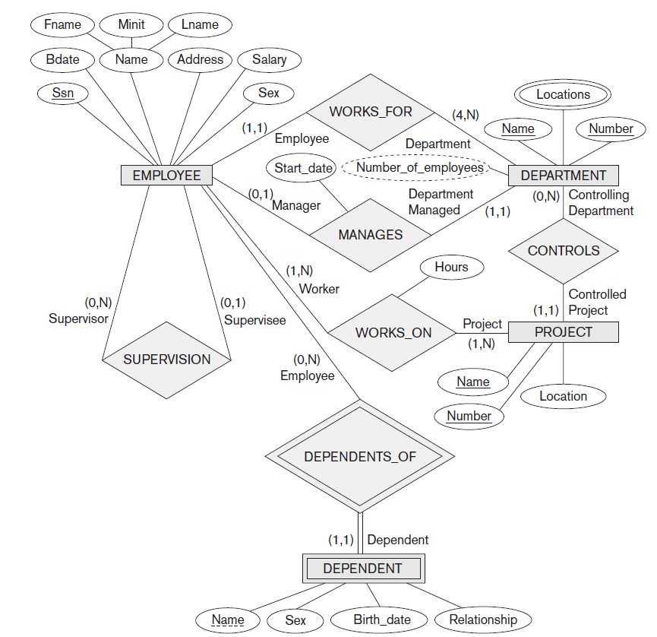
ER Diagrams, Naming Conventions, and Design Issues

Slide 16
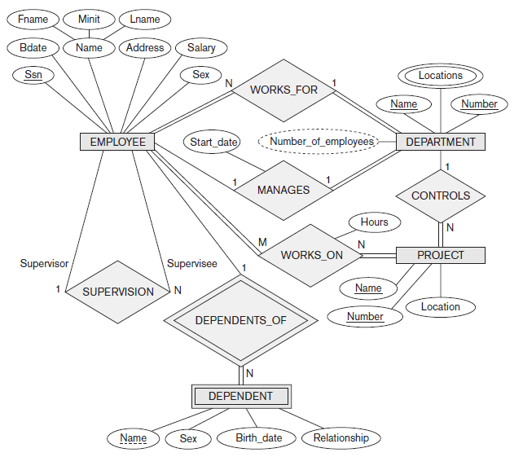
A Sample Database Application

